Slide 1







Slide 2


Graduate work
By discipline:
Web development
Topic of the thesis:
Payment system
Student:
Zinchenko Bogdan
Supervisor:
Tabashnyuk Evgeny

Slide 3

Content
1. Goal of the work
2. Project architecture
3. Technology stack
4. Functionality
5. Security
6. Outcome
7. Questions and answers

Slide 4

Goal of the work
The goal of this project is to develop and implement a payment system similar to PayPal using the Django framework.
The main goal of the work is to create a reliable, convenient and secure payment system that will allow users to make online payments, transfer funds and manage financial transactions with minimal risks and maximum protection of personal data.
The project is also aimed at demonstrating web development skills and applying modern technologies in the field of payment systems.

Slide 5

Project architecture
The project architecture is based on REST API and JWT tokens, provides modularity, scalability and security of the payment system. It allows you to efficiently process user requests, perform authentication and authorization, as well as store and process payment and user data.
The project architecture is based on the principles of client-server architecture and includes the following components:

Slide 6

Backend / Frontend
The client part:
The frontend is designed using HTML, CSS and JavaScript to create an interactive user interface. The client part interacts with the server part via the REST API.
Server part:
The backend is developed based on the Django framework using the Django REST Framework to process requests and provide data to the client. Authentication and authorization is carried out using GWT (JSON Web Token).
Database:
A PostgreSQL relational database was chosen to store the information. Django ORM is used to simplify working with data and ensure data consistency. Networking:
Clients and server communicate using HTTP. The client sends requests using HTTP methods to perform payment operations, account management and other system functions.

Slide 7
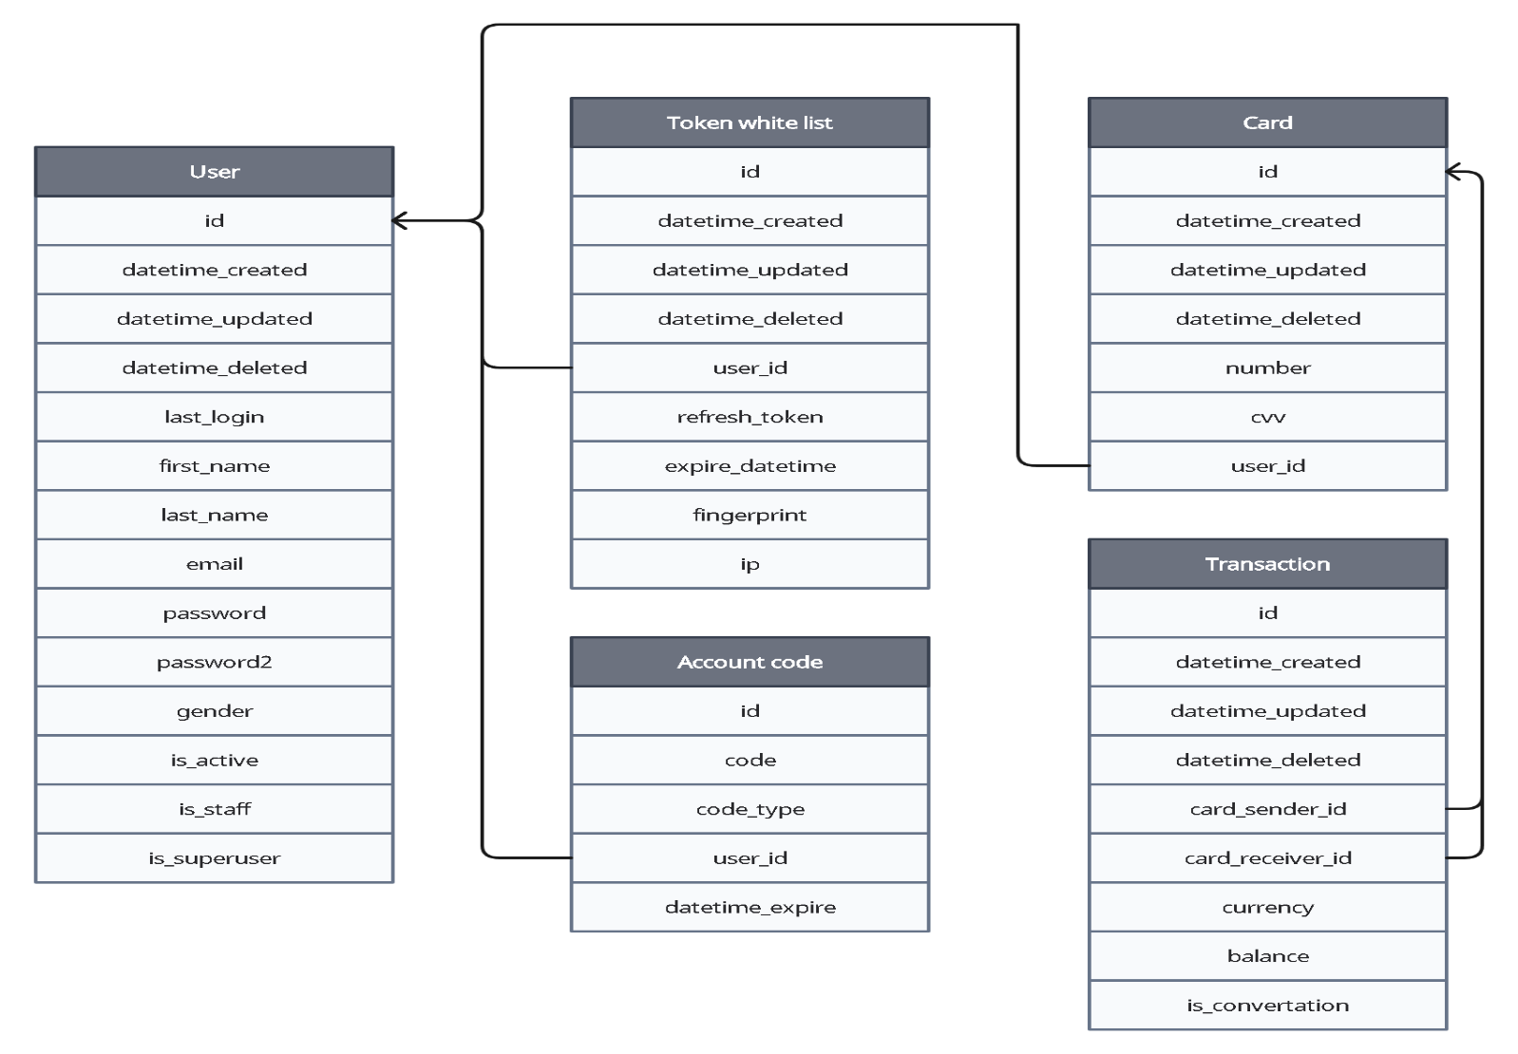
Database schema
Picture 1. Common database schema

Slide 8

Division of responsibilities
The project is organized in the form of two main components: frontend and backend. The frontend represents the user interface, while the backend represents the backend of the application. In order to structure and simplify the code, the backend is further divided into three separate parts: bank, auths and abstracts.
auths - management of users and various tokens.
bank - card and transaction management.
abstracts - extending the functionality of the other parts.
Each of these parts has its own specific responsibility, which ensures logical separation and clarity within the project. The responsibility within them is divided as follows:

Slide 9
Division of responsibilities
Views are the entry points to the application for accepting incoming requests and determining the logic of their processing.
Models establish a connection between the application and the database to receive and record information.
Controllers represent the business logic of the application. They serve as a link between views and models.
Serializers provide serialization and deserialization of data, their formatting in json and back for convenient communication with frontend.
Validators are used to validate and validate data to exclude in-server errors.

Slide 10

Technology stack
In the process of writing this project, the following technologies were used:
Django – main framework for application development.
Django rest framework – framework, that allows to easily create rest api
with built-in tools for authentication and validation.
SimpleJWT – realization of JWT (JSON Web Tokens) for secure
authentication of users.
Debug-toolbar – django library, that adds interface to debug add optimize
SQL queries.
PostgreSQL – it is a powerful and extensible relational database management
system that ensures data reliability and integrity.

Slide 11
Technology stack
In the process of writing this project, the following technologies were used:
Redis – tool, that allows to cache data to reduce the load on the database.
Celery – tool, that allows to execute expensive code on the background.
Sentry-SDK – tool, that allows to track and analyze emerging errors and exceptions.
Axios – famous JavaScript-library for executing asynchronous HTTP-requests.
Fingerprint - JavaScript-library, that allows to create unique ID of device or browser
based on the available characteristics of the client environment.

Slide 12
Technology stack
In the process of writing this project, the following technologies were used:
BeautifulSoup – library for parsing data from HTML and XML files.
Pickle – library for serializing (convert objects into byte-code)
и deserializing (convert byte-code to objects).
Requests – library for getting data from websites using HTTP-requests.
Fernet – module from library cryptography for encrypting
And decrypting data using symmetrical key.
Flake8 – tool for static analyzing of code, that check syntax and style of
code for compliance with PEP 8.

Slide 13
Functionality
The payment system supports the following functions:
Registration: Users can create their own accounts by specifying all the necessary information.
Account activation: After registration, the user must confirm the action by entering the code sent to the mail.
Authorization: Registered users can log in using their credentials.
Creating cards: Users can create their own virtual cards to make payments and transactions in the system.

Slide 14
Functionality
The payment system supports the following functions:
Balance Replenishment: Users can replenish their balance in various currencies.
Currency Conversion: Users can also exchange one currency for another using the current exchange rate.
Money Transfer between cards: Users can transfer funds between cards.
View transactions and filter them: Users can view and track their financial activity.

Slide 15

Security
Using PostgreSQL
PostgreSQL is a powerful and scalable database management system. It copes well with high loads, encrypts data, supports access rights differentiation, ensures data integrity and reliability of operations.
2. Data encryption in Redis
Using Fernet to encrypt data before storing it in Redis. Adds an extra layer of security.
3. Using GWT (JSON Web Token)
JWTs contain user information that can be verified and confirmed by the server.
This allows you to make sure that the data is reliable and requests come from authorized users.

Slide 16
Security
4. Activation code
After registration, a special code is sent to the user to confirm the account, which will not allow attackers to do anything on his behalf.
5. Password hashing
In case of data leakage, the user's password will remain hashed, which will not allow attackers to find it out.
6. Using CSRF tokens
The use of csrf tokens when submitting the form prevents cross-site forgery of the user's request by intruders.

Slide 17
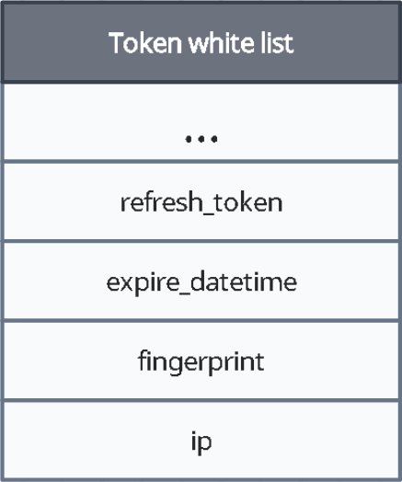
Security
7. Storing refresh tokens in the database
Storing tokens in the database allows you to revoke tokens if necessary and track suspicious activity on the part of the user. It also allows you to add additional fields for better security when using JWT.
refresh_token – tracking whether this token was actually issued and whether it is active now.
expire_datetime – verification of the authenticity of the token.
fingerprint – a special hash generated at the time of login to the account, based on the unique properties of the client. Stored in a cookie with the SameSite=strict flag to protect against CSRF attacks.
ip – last check in case all other data has been stolen.
Picture 2. The scheme of the
whitelist of refresh tokens

Slide 18
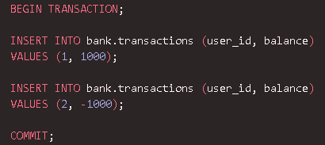
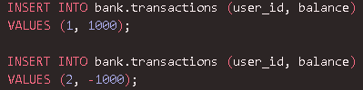
Security
8. Using django.db.transaction.atomic
An atomic transaction guarantees that all operations will be performed either completely, or none of them will be performed. This provides a guarantee for users that their money will not be accidentally lost in the event of a failed transaction.
Figures 3 and 4 show examples atomic and normal transactions.
In case of an unexpected error after entering № 1, the atomic transaction will make a rollback and the changes will not be saved.
However, when using simple transactions, change № 1 is immediately saved and leads to data inconsistency.
Picture 3. Example of an atomic transaction
Picture 4. Example of a normal transaction

Slide 19

Outcome
After several weeks of hard work on the Django-based payment system project, I managed to achieve the desired result. I was able to create a functional and easily extensible system that provides a user-friendly interface for secure payment transactions and money storage.
The creation process turned out to be extremely fascinating. The thesis allowed me to better understand some technologies, for-example, Celery and JSON Web Token. I was also able to better understand the architectures MVC, REST and understood how the integration of the backend with the frontend takes place.
During the development process, I encountered the following problems: using JWT, connecting Celery and writing front-end.
The following sources helped me in solving these problems:
JWT, Celery, axios, fingerprint.

Slide 20

Thanks for your attention
This concludes the presentation.
If you still have any questions,
I am ready to answer them.
Github: https://github.com/anigilyatornayapushka Phone number: 87776548573 Telegram: @zusjjaka

